Slide 1
B-Trees

Slide 2
B-Trees
B-Tree is a self-balancing search tree. In most of the other self-balancing search trees (like AVL ) it is assumed that everything is in main memory.

Slide 3
Concept behind B-Tree
To understand the use of B-Trees, we must think of the huge amount of data that cannot fit in main memory. When the number of keys is high, the data is read from disk in the form of blocks. Disk access time is very high compared to the main memory access time. The main idea of using B-Trees is to reduce the number of disk accesses.

Slide 4
B-Trees : Concept
Most of the tree operations (search, insert, delete, max, min, etc ) require O(h) disk accesses where h is the height of the tree.
B-tree is a fat tree. The height of B-Trees is kept low by putting maximum possible keys in a B-Tree node.
Generally, the B-Tree node size is kept equal to the disk block size. Since the height of the B-tree is low so total disk accesses for most of the operations are reduced significantly compared to balanced Binary Search Trees like AVL Tree, Red-Black Tree, etc

Slide 5
Properties of B-Tree
For balancing the tree each node should contain n/2 keys. So the B tree of order n can be defined as:
All leaf nodes should be at same level.
All leaf nodes can contain maximum n-1 keys.
The root has at least two children.
The maximum number of children should be n and each node can contain k keys. Where, k<=n-1.
Each node has at least n/2 and maximum n nonempty children.
Keys in the non-leaf node will divide the left and right sub-tree where the value of left subtree keys will be less and value of right subtree keys will be more than that particular key.

Slide 6
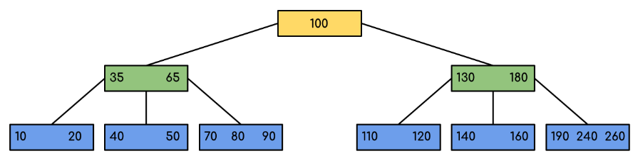
Example

Slide 7
Example: Searching 120 in the given B-Tree

Slide 8
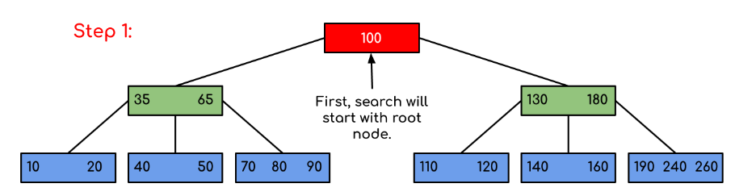
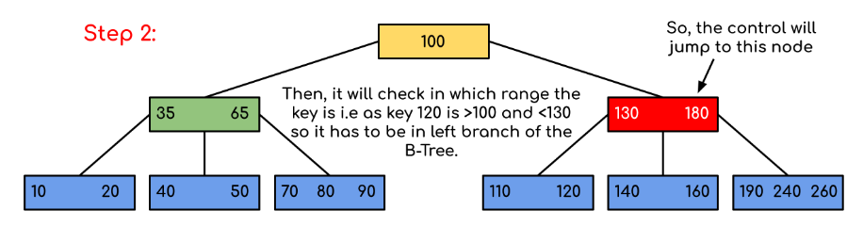
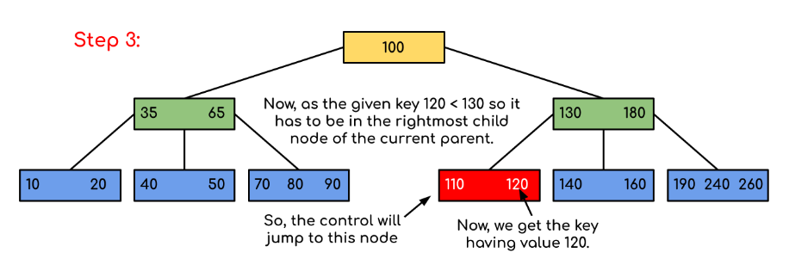
Solution:

Slide 9
B-Tree performance
Let h = height of the B-tree.
get(k): at most h disk accesses. O(h)
put(k): at most 3h + 1 disk accesses. O(h)
remove(k): at most 3h disk accesses. O(h)
h < log _{d} (n + 1)/2 + 1 where d = ⎡m/2⎤ (Sahni, p.641).
An important point is that the constant factors are relatively low.
m should be chosen so as to match the maximum node size to the block size on the disk.
Example: m = 128, d = 64, n ≈ 64³ = 262144 , h = 4.

Slide 10
2-3 Trees
A B-tree of order m is a kind of m-way search tree.
A B-Tree of order 3 is called a 2-3 Tree.
In a 2-3 tree, each internal node has either 2 or 3 children.
In practical applications, however, B-Trees of large order (e.g., m = 128) are more common than low-order B-Trees such as 2-3 trees.

Slide 11
Which of the following is the most widely used external memory data structure?
a) AVL tree
b) B-tree
c) Red-black tree
d) Both AVL tree and Red-black tree
CSE 373 -- AU 2004 -- B-Trees

Slide 12
CSE 373 -- AU 2004 -- B-Trees

